Slide 1

Public Health at Cheshire East Council
"I really enjoyed working with the team and would definitely recommend training in Cheshire East"
"I have found the public health team at Cheshire East to be very friendly and welcoming during my time here"
"They have a good understanding of the curriculum, ensure that work meets my training needs"
Including a new split placement offer with East Cheshire Trust in Macclesfield
UKPHR Employer of the Year 2023
ADPH Team Award 2023
For more information contact Matthew.Atkinson@CheshireEast.gov.uk

Slide 2
About Cheshire East Council
We hope you’ll join us in Cheshire East, where we can offer an interesting mix of work within a fabulous team. We’ll provide the right mix of support and challenge to give you the best training experience possible.
Our Council provides services for about 400,000 residents and is the third largest local authority in the North West. We offer a varied public health experience with many unique challenges:
An ageing population with pockets of deprivation across our rural areas and the need to support connectivity with people and services
Urban deprivation in our main towns, especially Crewe, with stark health inequalities seen in our most marginalised communities
Claire McIver will start as our new Director of Public Health in spring 2026 and we’re really excited about this new phase for our team!
We operate a hybrid model of working and have an office base in Crewe as well as Macclesfield. Trainees can also work from home and are issued with a laptop.
Our small team covers a big area. 7 of the other 8 local authority areas in Cheshire and Merseyside could fit in Cheshire East with room to spare!

Slide 3
What experience can you gain from Cheshire East?
ST1-2
Excellent grounding in public health knowledge through our tutorial programme.
Opportunities to gain health intelligence expertise through our ambitious Joint Strategic Needs Assessment programme, local authority experience in health protection, and numerous opportunities for gaining experience in project management, risk management, evaluation, evidence appraisal and informing senior decision makers.
Opportunity to lead the development of the Annual Report of the Director of Public Health
ST3-5
Opportunities for systems leadership through:
Leading work across our integrated care partnership
Leading pharmaceutical or joint strategic needs assessment reviews.
Bespoke health and care public health experience shaped by our dedicated Health and Care Consultant in Public Health, linking in with primary and secondary care.
We have developed a split placement with East Cheshire NHS Trust (Macclesfield) for 2026. Please ask if you’re interested!
Leadership opportunities in Neighbourhood Health development, our council transformation programme, and devolution in Cheshire and Warrington.
Throughout
Opportunities for gaining experience in teaching and supervision of junior doctor colleagues from other specialties.
A great degree of flexibility in shaping your training experience

Slide 4
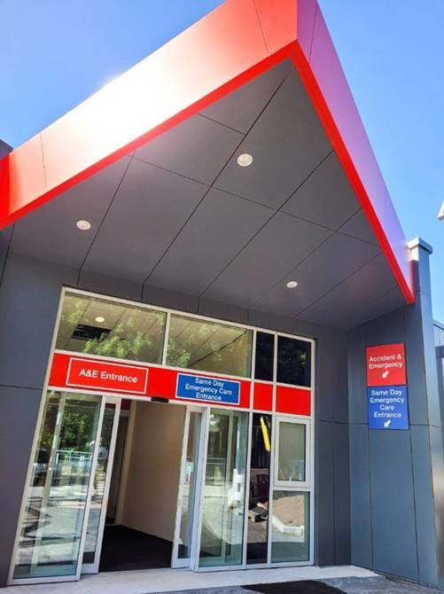
Placement with East Cheshire Trust
For senior trainees, we offer a split placement with East Cheshire Trust.
You will spend at least half of your time with us in CEC but for the remainder of the week will work with the Medical Director in Macclesfield General Hospital on a range of healthcare public health topics
We can also explore a split placement with another organisation if you wish to discuss that

Slide 5
The public health team
2020 to 2025
Who we are
We delivered an effective response to COVID-19 that received national recognition. The team is now redoubling its efforts to reduce inequalities and tackle the wider determinants of health and wellbeing across Cheshire East.
Our team is providing leadership in many key areas representing opportunities to improve population health, including:
The emerging Place Partnership and integrated care system, and a move to neighbourhood health
A major programme of investment and regeneration in Crewe
The wider activity that the Council and its partners undertake
Giving young people the best start in life
We have a friendly and knowledgeable public health team across health improvement, health intelligence and health protection and work closely with colleagues in Commissioning to deliver vital services for our residents.
Whilst we sit in the Adults, Health and Integration directorate, our work spans the whole Council and we collaborate with partners across health and social care, the voluntary sector and in our communities, both in Cheshire East and across Cheshire and Merseyside.

Slide 6
Claire McIver – Director of Public Health
Claire has over 20 years’ experience working in various public health roles, both in the NHS and local government, and became a Consultant in Public Health via the defined specialist portfolio route. She joined Cheshire East as the DPH in March 2026.
Claire is passionate about workforce development and is an educational supervisor, as well as an informal supervisor and mentor for several portfolio route candidates. She is an advocate for all types of public health expertise and is always keen to develop internal talent as well as to support the wider public health workforce to achieve their ambitions.
Claire believes public health is one of the best careers you can have! It is always challenging, never dull, and very rewarding.
Dr Susan Roberts – Public Health Consultant
Susie joined the team in July 2021. She is a Consultant in Public Health and Consultant lead for Health Intelligence and Children and Young People. Her previous experience as a junior doctor in hospital and as a GP has led to her passion for promoting wellbeing and preventing ill health at the earliest opportunity, from birth and throughout life. She is also passionate about joining up services to support people in the right way when they need it.
Guy Kilminster – Corporate Manager for Health Improvement
Guy is responsible for helping to ensure that the residents of Cheshire East have long and healthy lives. Guy works with partners (internal and external) to address issues that might be contributing to health inequalities and premature mortality.
He is closely involved in the work of the Cheshire and Merseyside Health and Care Partnership and the integration of health and care in Cheshire East. He also works on sub-regional priorities, for example reducing alcohol-related harms and supports the DPH to ensure effective functioning of the Health and Wellbeing Board.
Dr Matthew Atkinson – Public Health Consultant and Lead Trainer
Matt worked in critical care, anaesthetics and acute medicine before joining the Public Health StR training scheme in 2015. He joined Cheshire East for his final placement before becoming a consultant in late 2022.
Matt leads on health protection and health and care public health and has an interest in health informatics and digital leadership. His focus is on maximising opportunities for prevention and the reduction of inequalities in the organisation and delivery of health and care services.

Slide 7
The trainee team at Cheshire East Council
We currently support (or have recently supported) a number of trainees within our team:
  Foundation doctors in both Mid Cheshire Hospital Trust (Leighton - Crewe) and East Cheshire Trust (Macclesfield)
  GP specialty registrars
  Public health specialty registrars
  Public health practitioners
  Local government trainees
Susie and Matt are educational supervisors, and more senior trainees may be supervised by our DPH. We’re all keen to teach and provide exam support as necessary
Projects will be allocated based on training needs and development areas, with more senior trainees taking on a portfolio of work to help ready them for consultant practice.
We are currently recruiting for a Local Authority Research Practitioner (LARP) to strengthen the Council’s approach to evidence-based prevention and increase our research and evaluation capacity and capability.

Slide 8
Trainee Perspectives
Dr Henna Reddy – ST1&2 Public Health Registrar
The public health team at Cheshire East have been incredibly welcoming, friendly, and supportive throughout my time here. I’ve worked closely with a range of team members on varied projects, including leading the Director of Public Health Annual Report and contributing to data appraisal for the Pan Cheshire Child Death Overview Panel, as well as opportunities for teaching and supporting the supervision of junior trainees.
The work I’ve done has enabled me to engage with a wide range of stakeholders, from schools, youth services and the voluntary sector to other council teams. I’ve really been able to get a clear picture of how public health is delivered at a local level, the partners we work with, and contribute in ways that feel meaningful.
Everything has felt appropriate for my stage of training and relevant to the curriculum, while still being challenging and supporting my development. I’ve always felt comfortable reaching out for support from my supervisor and the wider team when something feels a bit out of my depth. I’ve really enjoyed my time at Cheshire East and would highly recommend it as a training placement.
Dr Matthew Atkinson – ST5 Public Health Registrar (prior to CCT and obtaining consultant post)
I had a fabulous year in Cheshire East and received just the right balance of challenge, responsibility and support. My work programme was tailored around getting my final learning outcomes signed off and preparing me for consultant practice.
I led the development of a strategy for reducing inequalities in Crewe as well as working on healthy ageing in rural areas and evaluating an NHS health improvement programme – a really interesting mix of work.
I really enjoyed working with the team and would definitely recommend training in Cheshire East. I was thrilled to be offered a consultant post here.
Dr Cathy Gregory – ST1&2 Public Health Registrar
I would highly recommend a placement at Cheshire East. My supervisor and the other consultants have been extremely supportive and approachable. They have a good understanding of the curriculum, ensure that work meets my training needs and I have been able to take on work that aligns with my interests.
The atmosphere of the team is friendly and inclusive and I feel my contribution is valued. There is a flexible hybrid working arrangement and the IT provision is good.
I have been able to gain experience in healthcare public health within the Local Authority, which is an area of interest to me.
For more information contact Matthew.Atkinson@CheshireEast.gov.uk

