Slide 1

Simulation Immersive Technology to support Education Learning & Training
Beyond the Horizon:
The Future of Education in Healthcare
Wednesday 21 September 2022
HEE TEL Team
Professor Pramod K Luthra Associate Postgraduate Dean
Sue Hughes
Kyle Goulding and Michelle Judson & the ILTO team

Slide 2
Introduction
Will describe some of the technical tools, software and general considerations involved in supporting the delivery of learning
delivery of learning employing multiple virtual world and real world learning modalities.
It is intended to assist anyone considering developing or accessing learning and simulation resources involving immersive technology, particularly learners and trainers in HEE NW.

Slide 3


Pre workshop
Post workshop

Slide 4
A national vision for the role of simulation and immersive technologies in health and care
• Improving patient safety
• Delivering a modern workforce
• Enhancing the quality and capacity of the learning environment
• Involving patients and the public
• Developing the simulation and immersive technology community
• Research and innovation.

Slide 5
Project Plan
What you wish to develop/research etc.
Why
Hope to achieve
How will you Evaluate, and Quality assure

Slide 6
Pre-development phase
What exists already? -If you are planning to create any new content or resources consult the available folks and site.
Intended learner: Will your resource be relevant to a select specialty group, cross specialty or even multi-professional – scoping exercise
Theme: What area(s) will you focus on? Some examples:
Aims and Learning Objectives:
  overall aims of your resource
  specific learning objectives
  mapping to existing curriculum competencies
Development type: How will you develop your resource

Slide 7
Theme: What area(s) will you focus on? Some examples
Clinical Management
Technical/ surgical skills
Ward/outpatient
Induction
In-situ simulation scenarios
Leadership/team
Nontechnical skills
Communication
Human Factors
Patient safety learning

Slide 8
Development type:
How will you develop your resource? - All three options will require sufficient capacity from your team, in planning, filming, editing, reviewing, and rolling out the resource.
In-house development – the team may have the expertise, skills, knowledge and have equipment and/or software to develop
Co-development option – Team has some expertise and knowledge, access the TEL team to develop content. Can lease equipment and software from HEE TEL XR Hub.
VR developer – commission a VR developer to develop resource. Can seek advice from the TEL Team and commercial developers.

Slide 9
Project Management
Core project team
Other advisors and/or stakeholders
Budget, deadline and flexibility
Equipment, resources
Can the VR developer assist with any scenario development, procuring actors, evaluation

Slide 10
Development Phase
willingness to adapt the resource content, design and even the structure
frequent review of your content (such as footage and written content) as you create it.
involve wide range of professionals and subject matter experts to ensure you get the suitable fit for the plan/ project.

Slide 11
Post-development phase
Sharing of any new resources - network across Trust, Deanery and HEE TEL
Roll-out: signposting learners to a resource link, holding dedicated workshops (either face to face or virtual) or hybrid - new remote resources with face to face training / simulation courses / events
Optimising engagement: Promotion of new resources is vital , how you can engage with learners via learner rep groups, social media, Trust, Deanery. Speak to your local Comms team via your local HEE office.

Slide 12
How to access immersive technology learning resources
There are a number of different VR headsets available to lease from HEE TEL that will enable meeting different training needs. Please see our list of suggested viewers below, based on our experience using these including in pilot evaluations, and with advice from the TEL team. If a team / Trust / School wished to purchase viewers which are not listed here, we would encourage them to consider why that headset would be particularly useful.

Slide 13
XR- Extended Reality
- VR – Is virtual action in a virtual environment. VR places individuals in another location Occludes the user’s natural environment entirely. The content is 100% digital
- AR - the visible natural world is orientated with a large digital content. It does not disengage from natural world. The digital content overlays real world
- MR - a virtual object set against the real world. Removes boundaries between the real and virtual world using occlusion by the viewing angle. It allows the interactive virtual elements to integrate and interact with the real external environment
Technology and simulation should support and supplement existing learning methods to provide education and training

Slide 14
XR

Slide 15
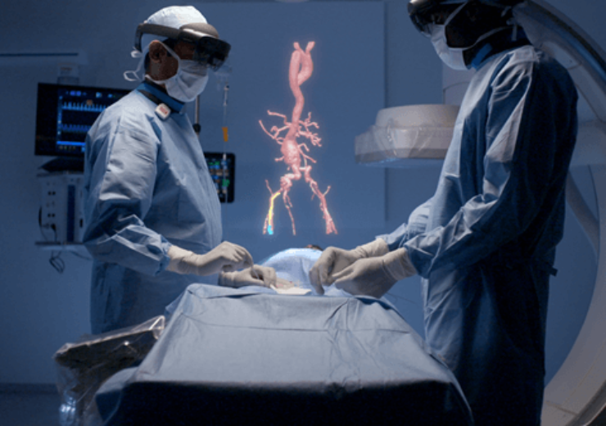
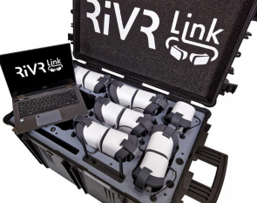
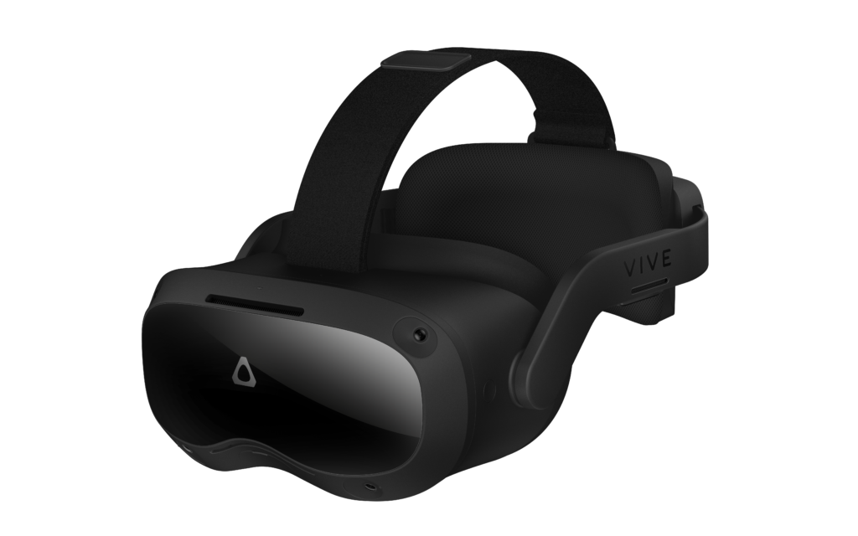
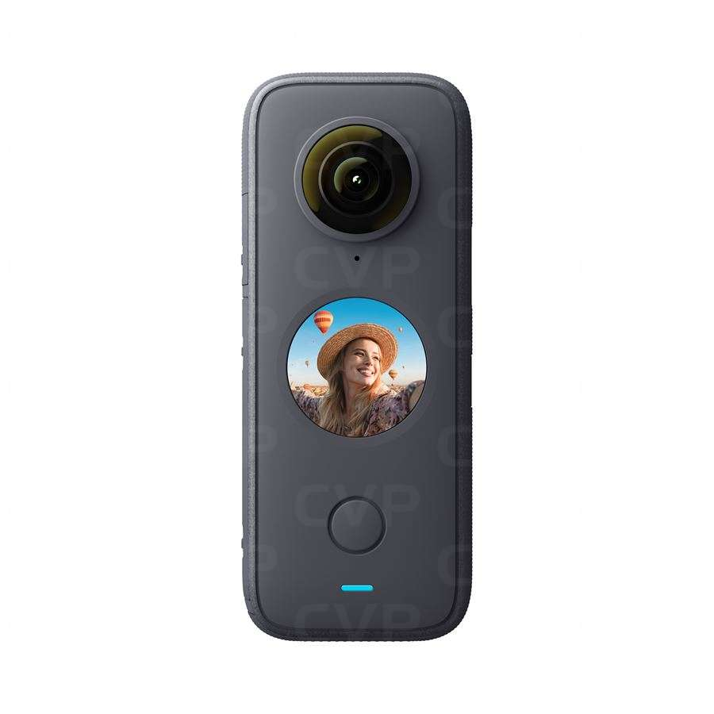
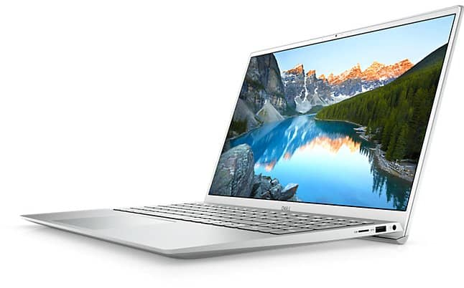
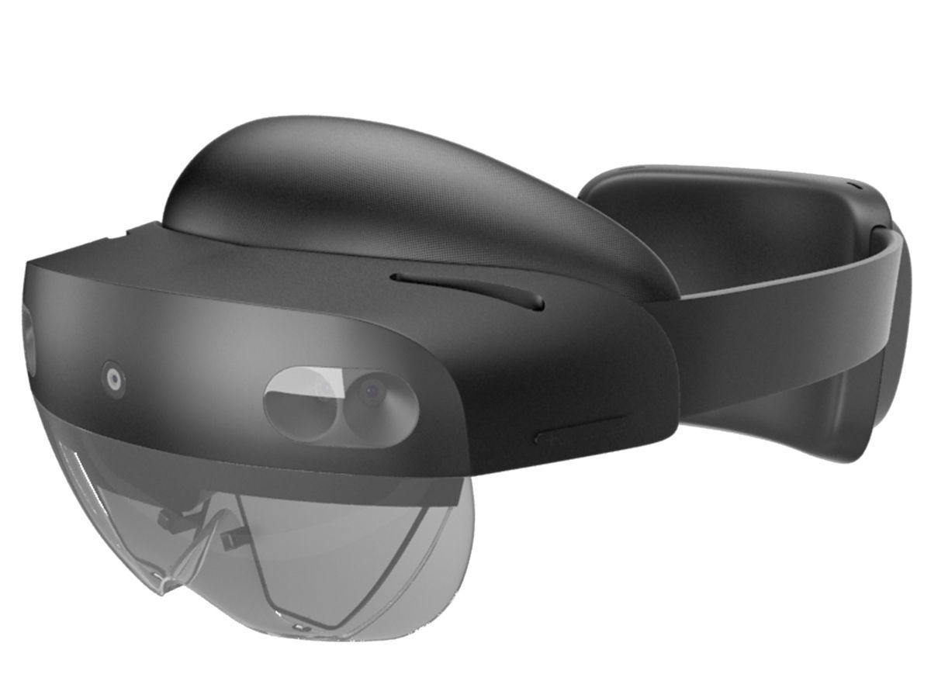
XR Hubs Pilot
Virtual XR regional hubs will offer access to a choice of 4 different packages that can be deployed on a short or longer term basis (1-6 months) according to intended use and priority of needs.
Augmented Reality (AR)
Virtual Reality (VR)
Virtual Reality (VR)
Content Creation
Microsoft HoloLens 2
Packs of 5 devices
HTC VIVE Pro
Packs of 5 headsets
Pico G2 4K
7 packs of 20 headsets (classroom pack)
Create 360⁰ videos, etc
20 packs plus 3 advanced packs
Pilot in Progress
Pilot in Progress
Pilot Start Oct
Pilot Start Oct

Slide 16
XR Hubs Pilot Support Structure
First line:
TEL Support
Triage and Reporting
Advice and Guidance
Initial Issue Resolution
Logistics and Co-ordination
Email: TELSupport@hee.nhs.uk
Second line:
Immersive Learning
Technology Officers
Simulation expertise
Issue response
Escalate to 3rd line, if needed
Third line:
Suppliers & Supporting
TEL Relationship Managers
Suppliers:
Specialist device or software support
Escalate issue response
Supplier training 1st line 2nd line and stakeholders
Relationship Managers:
TEL-specific issues
Support with TEL Readiness
Broader organisational support

Slide 17
Existing Learning Resources, generally available Nationally
e-Learning for Healthcare (e-LfH) and the Learning Hub (LH)- require a GMC number or Athens password
HEE TEL - Learning Hub Catalogue

Slide 18
Any Questions
Thank You
Please complete the Feedback you can use the QR code below
Pre
Post

Slide 19
Workshop and hands on session
We will have 3 working stations led by the HEE TEL Team. The 3 areas covering each kit starting with a brief introduction and then hands on for as many as possible. The stations will stay on over lunch if you wish to return and try out or discuss.
Please stay in your group and each group will spend 20 minutes at each station and rotate to the next station.
We will come together as a single group for the final 10 minutes for any questions and discussions.
Please send feed back to the team as on the QR code.
If you need to submit a bid for a specific kit please provide a brief plan following discussion with the DME and/or Head of School and send the bid to me and copy Sue Hughes at
Pramod Luthra – Kerri.Anne.Weir@hee.nhs.uk & Pramod.luthra@hee.nhs.uk
Sue Hughes - Suzanne.Hughes@hee.nhs.uk

