Slide 1
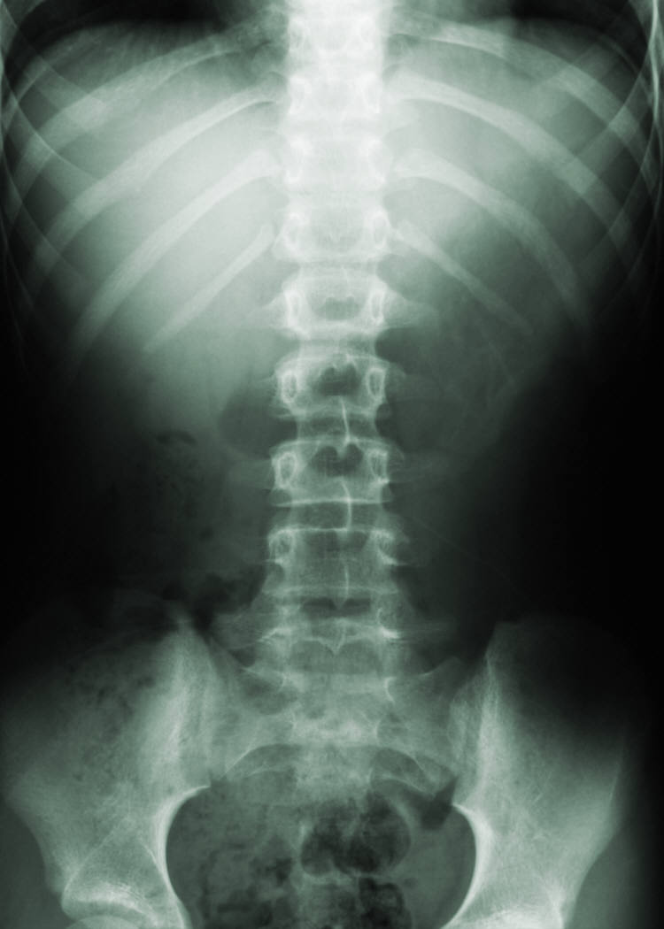
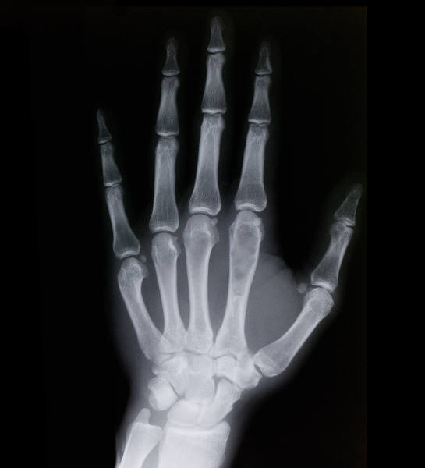

Information Pack for Doctors in Training
Lead Employer HENW (Mersey)
If you have any questions or if there is anything a member of the team can do to assist you, please let us know. We will be happy to help.
Lead Employer Services
St Helen’s & Knowsley Teaching Hospitals
NHS Trust
Lower Ground 1
Nightingale House
Whiston Hospital
Warrington Road
Prescot
L35 5DR
Tel: 0151 290 4186 / 430 7674 / 430 7675 / 478 7672
e-mail: lead.employer@sthk.nhs.uk
This information pack includes details you may want to know such as pay dates and leave entitlements, as well as introducing you to some of the services provided by the Lead Employer Service – including an Employee Assistance Programme and HR Direct.
We wish you the very best,
Lead Employer Services Team
April 2015
Welcome note
Dear trainees,
Congratulations and welcome to the Lead Employer Service and HENW -Mersey.
About Us
The Lead Employer Team at St Helens & Knowsley Teaching Hospitals NHS Trust is your employer during your training period with Health Education North West (HENW) Mersey
We provide payroll, recruitment and selection, administration, occupational health services and human resource advice on the following:
Recruitment and selection
Pre-and post-employment checks
Contracts of employment
Travel expenses
Payroll services
Issuing rotation correspondence
Acceptance of resignations
Attendance management
Occupational Health
Immigration and applications to the Home Office
For further information please refer to HR Direct: www.leademployer.sthk.nhs.uk
“As a HR team we are very proud of the support we provide to our trainees. Feedback from host trusts, the trainees, HENW (Mersey) and the British Medical Association about the improvements we have made since taking over the contract 4 years ago have been very positive. The quality of service was also noted in a recent General Medical Council (GMC) survey.”
Spencer McKee, Assistant Director of HR for the Lead Employer Service,
St Helens & Knowsley Teaching Hospitals NHS Trust

Slide 2
Working in Partnership
Lead Employer HENW (Mersey)
HENW (Mersey)
Health Education North West (HENW) - Mersey provides services related to your education and training programme.
They advise on and approve posts, programmes, rotations, ARCPs and college issues:
Approves and provides post & programme details to the Lead Employer Service
Provides details of rotation placements to the Lead Employer Service
Notifies issues emerging from the ARCP or college exams and reviews or other factors which impact on Certificate of Completion of Training (CCT) dates to the Lead Employer Service
Deals with “Out of Programme” requests
Deals with requests for and manages “Less than full Time Training” (LTFT)
Manages Inter-Deanery transfers (IDTs)
Manages all study leave requests and expenditure
For further information on issues related to your training and any of the items listed above please refer to HENW website:
www.nw.hee.nhs.uk
Host Organisations
Host Trusts / Organisations are the hospital, GP Practice or location where you will work and carry out your training. They provide a local induction and inform the Lead Employer Service about the following:
Pay banding
Sickness and absences
Human Resource issues
Mandatory Training
To access information on host organisations within HENW (Mersey) please refer to HR Direct
Local Negotiating Committee
The Local Negotiating Committee (LNC) is made up of local staff side representatives and BMA representation who meet on a quarterly basis with the Lead Employer to discuss contemporary issues on behalf of doctors in training employed by the Lead Employer.
If you have any issues you wish to seek advice on, your staff side representative can be contacted via e-mail at: Mersey.lnc@nhs.net
Also, minutes of the LNC are available on request. Please contact your relevant staff side representative via e-mail : Mersey.lnc@nhs.net
Junior Doctors Advisory Team (JDAT)
The Junior Doctor Advisory Team (JDAT) is an independent team of doctors working out-of-programme within Health Education North West. The JDAT is a successor body to the local regional action teams which were formed to ensure all trust rotas became compliant with the rules on working hours within the new junior doctor contract (the New Deal) in 1991. Further information is available on HR Direct

Slide 3
About you
Lead Employer HENW (Mersey)
Rotation
Leave
Changes to your Personal Information
All employees are requested to notify the Lead Employer in writing of the following changes:
Change of address
Change of name
Change of email address
Change of telephone numbers
Change of bank details.
All changes should be emailed to lead.employer@sthk.nhs.uk
Visa Information
If you do not hold a British or EEA passport, you must inform us immediately about any changes to your immigration status, and we always need to receive a copy of any renewed visa AND passport, regardless of your visa expiry date.
Letters Confirming Employment
Requests for letters to confirm employment for the purpose of visas need to be requested by emailing Lead.employer@sthk.nhs.uk in the first instance.
Registration and Licence to Practise
For all trainees excluding non-medic Public Health trainees, you are required to hold a current Licence to Practise and to be registered with the General Medical Council or, where required, the General Dental Council throughout the duration of your employment
If there are any changes to your registration with the GMC or GDC, you must advise us immediately by emailing: lead.emplyer@sthk.nhs.uk
Annual Leave
The annual leave year runs from first Wednesday in August. Your entitlement to annual leave will be:
For non-medic Public Health trainees, the annual leave year runs from 1st April – 31st March. Entitlement to annual leave is:
All annual leave must be arranged with prior permission and in accordance with the arrangements of your host organisation.
Where annual leave requests overlap a period of rotation between two host organisations, you must ensure prior authorisation is obtained by the appropriate representatives of both host organisations.
Public Holidays
You are entitled to 8 days public holidays per year, pro rata for less than full time employees.
Study Leave
Please refer to HENW Mersey website: www.merseydeanery.nhs.uk/studyleave
Out Of Programme
Please refer to the HENW Mersey website: www.merseydeanery.nhs.uk/out-of-programme-experience
Policies and Procedures
Policies which are applicable to you during your employment with the Lead Employer Service may be found on HR Direct
Less than Full Time Training
Please refer to HENW (Mersey) website: www.merseydeanery.nhs.uk/ltftt
You will receive a pro-rata leave entitlement, for further information please visit HR Direct
Inter-Deanery Transfers
Please refer to HENW Mersey website: www.merseydeanery.nhs.uk/inter-deanery-transfer
Resignation From Employment
In line with your appointment, you are entitled to receive the following notice of termination of employment and are required to give the Trust the same notice as detailed below:
Core Training (CT): 1 month
Specialty or Specialist Registrar: 3 months
All resignation letters should be emailed to
Lead.employer@sthk.nhs.uk
Induction at Host Organisation
You will receive an induction at the host organisation each time you rotate, which you must attend. The host organisation will advise you regarding local and departmental policies and procedures. This will include information relating to accommodation, car parking, facilities, fees, ID badges etc.
Pay Bands/Rotas/Pattern of Work
Queries relating to the allocation of pay bands, rotas and patterns of work must be made to the Medical Personnel Department at the host organisation where you will be working.
Less than full time trainees will receive pay band in line with NHS Employers Equitable Pay Guidance
You are reminded that you are contractually required to work with host organisations in monitoring hours of work.
Notification of Placements
If required , you will rotate to various work locations throughout your employment. Future rotational placements will be confirmed 8 weeks prior. Further details are available on HR Direct
The host organisation will provide you with the name of your assigned educational supervisor.
Point of salary Scale | Annual Leave Entitlement
Point 00 – 02 | 27 Days
Point 03 – 09 | 32 Days
NHS Years Service | Annual Leave Entitlement
0 - 4 | 27 days
5 - 9 | 29 days
10+ | 33 days

Slide 4
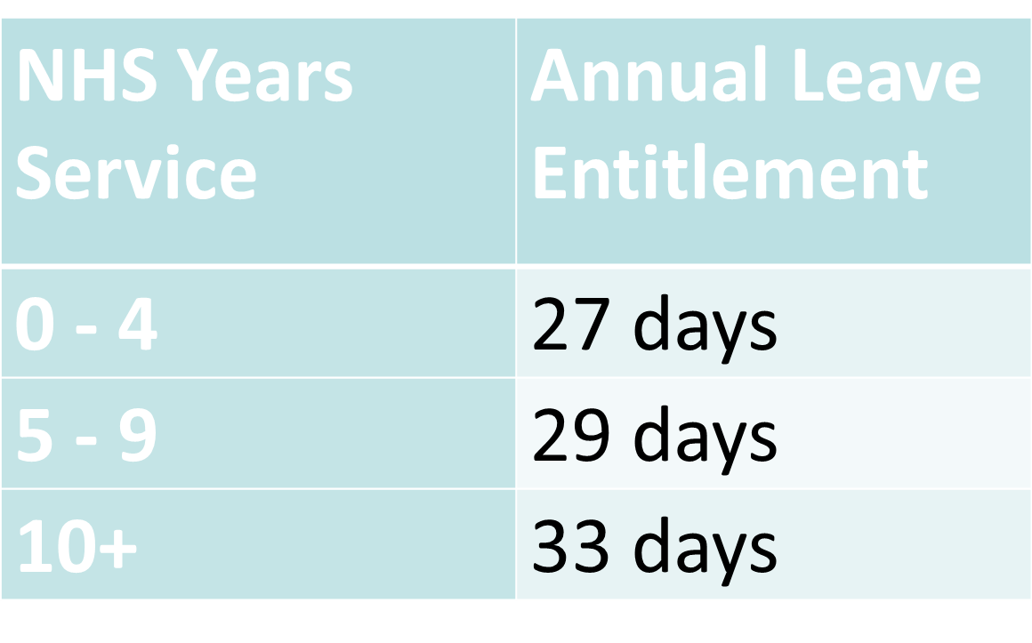
About you
Lead Employer HENW (Mersey)
The European Working Time Directive (EWTD) determines the maximum weekly working time, patterns of work and holidays plus the daily and weekly rest periods. It was enacted into UK Law as the Working Time Regulations from October 1998.
It is a contractual requirement of doctors in training not to breach Working Time Regulations.
Are You Regularly Working Over 48hrs Per Week?
If your answer is “Yes”, please contact lead.employer@sthk.nhs.uk
EWTD
In summary, the main features of the Working Time Directive for doctors in training are:
A limit of an average of 48 hours working time each week, measured over a reference period of 26 weeks (a rolling reference period).
A doctor in training may choose to work longer by “opting out”. However, they can only work for a maximum of up to 56 hours a week as per The New Deal restrictions, you must notify the Lead Employer if this is the case by emailing: lead.employer@sthk.nhs.uk It is essential that you still meet the required leave and daily & weekly rest requirements, which are:
11 hours continuous rest in any 24 hour period
24 hours continuous rest in 7 days (or 48 hours in 14 days)
A period of 30 minutes of paid relief (rest) for natural breaks taken approximately after every 4 hours of work, e.g. if a doctor in training works 8 hours they should get one break, if they work a 12 hour shift, it should be two.
5.6 weeks leave, which must be work free (you cannot cover locums with the NHS or any agency during the 5.6 week leave (work free period).
Rest requirements must be met by law. The Lead Employer may consider disciplinary action against anyone who breaches the EWTD/New Deal regulations.
LOCUM WORK
As part of your terms & conditions, you agree not to undertake locum medical or dental work for this or any other employer where such work would cause your contracted hours (or actual hours of work) to breach the controls set out in paragraph 20 of the Terms and Conditions of Service.
Should you be approached to undertake locum duties at a higher grade, you must (where practicable) obtain prior clearance to undertake such duties from the TPD/TPDC Chairman and Postgraduate Dean.
GMC Code of Good Medical Practice
The GMC Code of Good Medical Practice details the standards that doctors registered with the GMC are required to adhere to as part of their registration and employment. This includes the requirement to declare any criminal proceedings to Lead Employer as your employer.
Further information is available from the GMC website
Non-Medic Public Health Trainees only
Non-medic Public Health trainees are employed and paid as per Agenda for Change terms and Conditions
If you are a non-medic PH trainee, you are not required to hold GMC registration as part of your employment. Your annual leave year runs from April – March. Entitlement to annual leave is:
GPSTs only
Are you on the GP Performers List?
As a GP you must be included on the GP Performers List if you are based in a G.P. Practice or Primary Care. At the point you are advised of your GP placement, you must complete an application form for inclusion on the GP Performers List.. Further information is available on HR Direct
Medical Defence Organisation
The Lead Employer Service has ‘block cover’ from MDDUS, who will cover all GP Specialty Trainees that commence employment from August 2012 and are placed in a G.P. practice or Primary Care. You will not be required to obtain your own Medical Defence cover if you have commenced employment with Lead Employer after August 2012. Further information is available on HR Direct

Slide 5
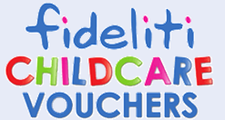
Pay Information
Lead Employer HENW (Mersey)
We provide a comprehensive range of payroll, expenses and pensions administration related services in a professional and efficient way.
If you have your ESR assignment number this will help us to answer your query more quickly. Assignment numbers can be found in the top left hand corner of your payslip from us.
Pay &Staff Services, Whiston Hospital, Lower Ground 1, Nightingale House, Warrington Road, Prescot, Merseyside, L35 5DR.
email: leademployerpayroll@sthk.nhs.uk
Specific contact details are available on HR Direct
Payment Of Salary
We pay employees on the 28th of each month. If the 28th of the month is a weekend day or a public holiday, we pay employees on the working day before e.g. Friday. We will pay you earlier in December and January.
Sick Pay
Entitlements are outlined in paragraphs 225 – 244 of the ‘Terms and Conditions of Service’
Salary Sacrifice Schemes
We run a number of salary sacrifice schemes and all windows of opportunity and brochures will be published on HR Direct.
Our schemes have included:
Computer Salary Sacrifice
Bikes for NHS
Childcare Vouchers
Our childcare voucher scheme is ran through Fideliti.
If you have any queries about the scheme please call 0800 288 8727 or find further information on their website: www.fideliti.co.uk
If you have any queries regarding your payments please contact Pay & Staff Services 0151 478 7723.
Tax Queries
You should address tax queries with HMRC
Tel: 0845 302 1462. Please quote PAYE Ref: 709 / STS11 and your N.I. number.
Pensions
Should you have any issues surrounding NHS pensions, you can direct your questions to Pay & Staff Services at leademployerpayroll@sthk.nhs.uk.
Further information can be obtained by visiting the NHS Pensions website: http://www.nhsbsa.nhs.uk/pensions
Mortgage Company / Letting Agency Applications
When applying for a mortgage or rented accommodation, your mortgage provider or letting agency should send their company form or request, together with your consent to release this information, to the Pay & Staff Services department. leademployerpayroll@sthk.nhs.uk.
Removal And Associated Expenses Policy
The Policy covers:
Travel in lieu of relocation
Relocation
Funding provision for removal and associated expenses
Process for obtaining reimbursement of removal and associated travelling expenses
Expenses on removal
Please refer to HR Direct to review this policy.
All queries should be e-mailed to lead.employer@sthk.nhs.uk
Business Travel Claim Forms
All completed travel claim forms must be authorised by your Supervising Consultant/GP Trainer at your host organisation and submitted to the Pay & Staff Services by the relevant payroll deadline
Please note that expenses must be submitted within 3 months of claim date, expenses submitted outside of this window will not be paid.
The latest forms can be found on HR Direct

Slide 6

Health Work & Wellbeing
Lead Employer HENW (Mersey)
The Health, Work & Wellbeing Centre is part of the St Helens & Knowsley Teaching Hospitals NHS Trust based at Whiston Hospital. Offering a range of services concerned with health and wellbeing.
The team is lead by the Wellbeing manager and includes a Wellbeing Physician, Nurse specialists, Physiotherapist, Chiropodist and Holistic therapist who are all supported by a clerical team.
Contact Us
Telephone Number : 0151 430 1985
e-mail address well.being@sthk.nhs.uk
Opening Hours
Monday to Friday from 8.30am – 4.30pm
Referral Service
The Lead Employer can refer trainees to the wellbeing service in accordance with the attendance management policy. All stress and musculoskeletal injuries must be referred immediately when a trainee goes off sick.
Self-Referral Service
Lead Employer trainees can self-refer. Please call the Wellbeing service on 0151 430 1985 to arrange an appointment.
Immunisation Queries
If you require immunisation history, please e-mail: well.being@sthk.nhs.uk with a request.
Needlestick Injuries
All needlestick injuries must be reported to your host organisation following their trust policy.
Information advice and support will be provided well.being@sthk.nhs.uk
Wellbeing Lead | Karen Brayley
Psychologist | Barry Lewis
Health Advisor | Joanne McClory
Alcohol Awareness Advisor | Angela Roberts
Smoking Advisor | Tracey Maxwell
Healthy Eating Advisor | Emma Knowles
Holistic Therapist | Claire Walley
Chiropodist | Barbara Hopkins
Wellbeing Admin Team | Clare Seabrook Elaine Foster Jonjo O'Neill Sue Barr Sindhu Ramakrishnan Amanda Heaton Margarita Fairchild
24:7 Employee Assistance Programme
Increasing demands are being placed on many of us, both at home and at work.
Stress, personal problems and work-related difficulties affect our ability to function effectively.
The Lead Employer Service has arranged for Oakdale a specialist independent provider of employee wellbeing services to provide free confidential counselling and advice helpline to all employees.
This service also provides legal and financial advice and information around:
Property
Family
Personal injury
Insurance
Debt
Taxation
Helpline: 0800 027 7844
email: casemanagers@oakdalegroup.co.uk
Website: www.oakdalegroup.co.uk

Slide 7
Useful Contacts
Lead Employer HENW (Mersey)
Online Information:
Lead Employer Service HR Direct Main Page
www.leademployer.sthk.nhs.uk
Policies & Procedures
HR Direct
News – Info Brief and Latest Updates
HR Direct
HENW Mersey Home Page
www.nw.hee.nhs.uk
Specialty Training Recruitment Website
www.specialtytraining.hee.nhs.uk
NHS Employers
www.nhsemployers.org
NHS Pension Scheme
www.nhsbsa.nhs.uk/pensions
GMC
www.gmc-uk.org
GDC
www.gdc-uk.org
BMA
www.bma.org.uk
Host Organisation Websites
Contact Us
Lead Employer Services
St Helen’s & Knowsley Teaching Hospitals NHS Trust
Lower Ground 1
Nightingale House
Whiston Hospital
Warrington Road
Prescot
L35 5DR
Tel: 0151 290 4186 / 430 7674 /
430 7675 / 478 7672
e-mail: lead.employer@sthk.nhs.uk
Health Work & Wellbeing
Tel: 0151 430 1985
e-mail : well.being@sthk.nhs.uk
Pay & Staff Services
e-mail: leademployerpayroll@sthk.nhs.uk
Host Organisation
Medical Staffing
GP Practices
Health Education North West – Mersey
Tel: 0151 285 4700 / 4701
5 Boroughs Partnership NHS Foundation Trust | www.5boroughspartnership.nhs.uk
Aintree University Hospital NHS Foundation Trust | www.aintreehospitals.nhs.uk
Alder Hey Children’s Hospital NHS Foundation Trust | www.alderhey.nhs.uk
Central Manchester NHS Foundation Trust | www.cmft.nhs.uk
Cheshire & Wirral Partnership NHS Foundation Trust | www.cwp.nhs.uk
Clatterbridge Cancer Centre NHS Foundation Trust | www.clatterbridgecc.nhs.uk
Countess of Chester Hospital NHS Foundation Trust | www.coch.nhs.uk
Glan Clwyd Hospital | www.wales.nhs.uk
Mid Cheshire Hospitals NHS Foundation Trust (Leighton) | www.mcht.nhs.uk
Royal Liverpool University Dental Hospital | www.rlbuht.nhs.uk
Liverpool Heart & Chest Hospital NHS Foundation Trust | www.lhch.nhs.uk
Liverpool Women's NHS Foundation Trust | www.liverpoolwomens.nhs.uk
East Cheshire NHS Trust (Macclesfield) | www.eastcheshire.nhs.uk
Marie Curie Hospice | www.mariecurie.org.uk
Merseycare NHS Trust | www.merseycare.nhs.uk
Nobles Hospital (Isle of Man) | www.gov.im/categories/health-and-wellbeing/hospitals-and-emergency-treatment/noble's-hospital
Royal Liverpool & Broadgreen University Hospitals NHS Trust | www.rlbuht.nhs.uk
Southport & Ormskirk NHS Trust | www.southportandormskirk.nhs.uk
St Helens & Knowsley Teaching Hospitals NHS Trust | www.sthk.nhs.uk
Walton Centre NHS Foundation Trust | www.thewaltoncentre.nhs.uk
Warrington & Halton Hospitals NHS Foundation Trust | www.warringtonandhaltonhospitals.nhs.uk
Wigan, Wrightington & Leigh NHS Foundation Trust | www.wiganleigh.nhs.uk
Wirral University Teaching Hospital NHS Foundation Trust | www.wuth.nhs.uk
Wrexham Maelor Hospital | www.wales.nhs.uk

