Slide 1
Public Health
Training Prospectus
2026

Slide 2
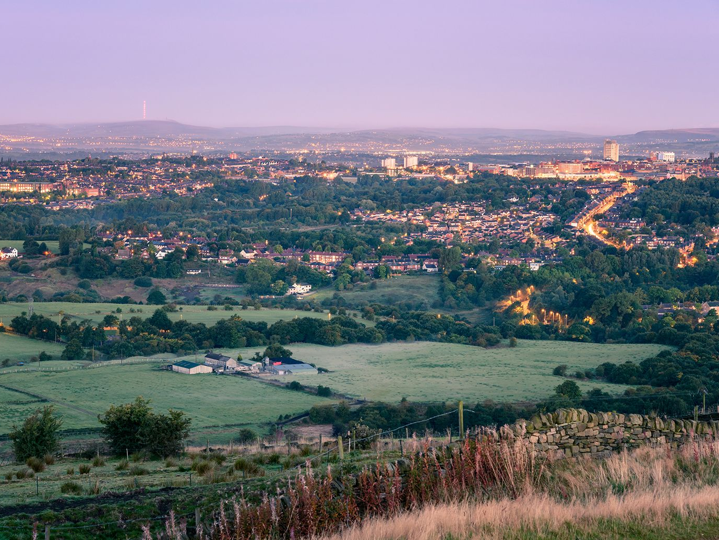
Notes:
Image: https://www.britannica.com/place/Oldham-England

Slide 3
Why choose Oldham Council?
From a registrar perspective…
“Oldham is a fantastic place to be a registrar at any stage. I was able to gain some valuable leadership experience, developing projects around health checks and team working. I was also able to work on some strategic pieces such as teenage pregnancy and health inequalities. Overall though the best thing about Oldham is the team - they are so friendly and welcoming, I really felt at home in Oldham”.
“Oldham has such an amazing Public Health team! There’s so much enthusiasm and a genuine commitment to improving people’s lives, and it’s probably the most welcoming place I’ve worked.”
“Oldham is a brilliant Local Authority placement, with varied opportunities for registrars at all levels. I came after time out of programme and working in the supportive Public Health team helped me to build back my confidence and transition into leadership roles. I’ll really miss it when I leave!”

Slide 4
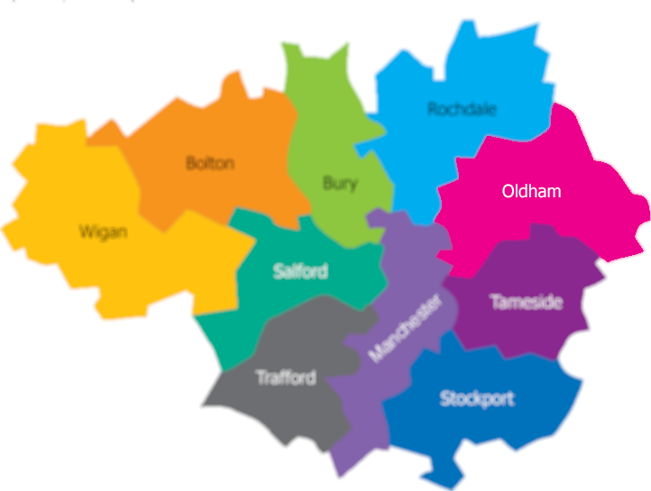
Introduction to Oldham
The borough of Oldham is situated in North West England and is part of Greater Manchester.
We are five miles away from Manchester city centre and close to superb countryside; almost a quarter of the borough is in the Peak District National Park. No household in the borough is more than two miles from open countryside.
We have diverse communities within Oldham, made up of people from a range of ages, backgrounds and cultures.
Notes:
https://www.gmmoving.co.uk/in-your-area

Slide 5
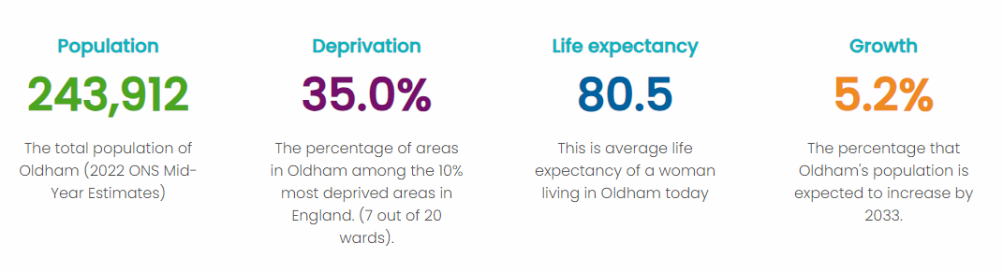
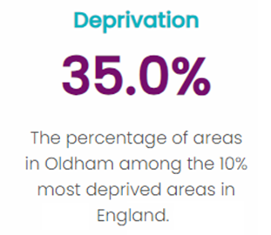
Introduction to Oldham

Slide 6

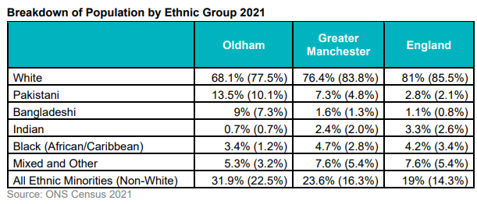
Introduction to Oldham

Slide 7
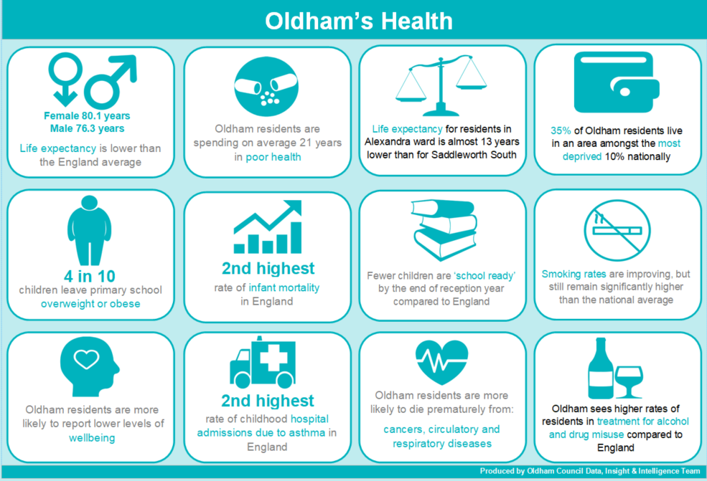
Public health in Oldham
Our population’s health is influenced by social inequality including poverty, unemployment, and disadvantage because of ethnicity. The wider determinants of health such as education, housing and transport are critical factors too.
Life expectancy for both men and women remains lower than the England average and life expectancy for residents in Alexandra ward is almost 13 years lower than for Saddleworth South.

Slide 8
Public health in Oldham
Whilst we are seeing improvements, many indicators suggest worse health and wellbeing than in the rest of the region and the national average.
More information is available here

Slide 9
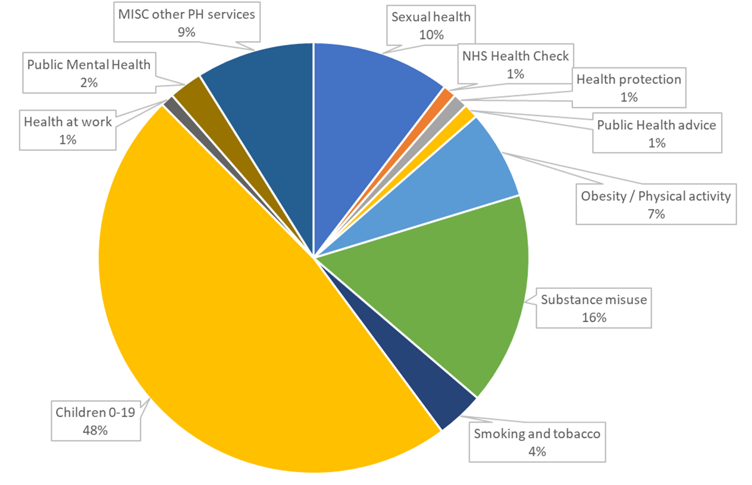
Public health in Oldham
Budget allocation 23/24

Slide 10
Oldham’s Public Health team
Oldham is a co-operative borough. This represents a commitment to developing a co-operative future where citizens, partners and staff work together to improve the borough and create a confident and ambitious place. It means working in a way which helps to empower residents to take greater control of their own lives and gets the maximum benefit from the resources that are available to the community and public sector.
The Public Health department sits within the Council’s People Directorate, alongside Sport, Leisure, Wellbeing, and Community led prevention.
The Public Health team comprises around 25 people and is led by the Director
of Public Health, Rebecca Fletcher, with support from two Consultants in
Public Health and the Head of Service.

Slide 11
Oldham’s Public Health team
Director of Public Health
Consultant in Public Health
(Health & Wellbeing)
Head of Service: Public Health
Consultant in Public Health (Healthcare)
Sport Leisure and Wellbeing Service Manager
Thriving Communities Hub Lead
Snr. Policy, Strategy & Commissioning Manager
Snr. Business and Commissioning Manager
Snr. Policy, Strategy & Commissioning Manager
Snr. Specialist Health
Protection Nurse
Sport Development Officer – Health & Physical Activity
Thriving Communities Project Manager
Policy & Strategy Officer
Commissioning Officer
Policy & Strategy Officer
Specialist Health Protection Nurse
Sport Dev. Officer – Physical Activity & LP Lead
Thriving Communities Project Support
Public Health Practitioner Apprentice
Finance and Corporate Support Officer
Programme Support Officer (Substance Misuse)
Active Through Football Project Manager
Business Support Assistant / Apprentice
School Swimming Teacher & Team Lead
Business Support
School Swimming Teachers

Slide 12
The training experience
Educational supervision
We currently have three educational supervisors, Dr Rebecca Fletcher, Dr Charlotte Stevenson, and Dr Lois Hall-Jones. We have capacity to host up to 3 StRs. Rebecca, Charlotte and Lois all trained in the North West, have a good understanding of the training scheme, and are accredited trainers.
Rebecca Fletcher is the DPH and is particularly interested in system leadership, sexual health, and children and young people.
Charlotte Stevenson is a Consultant in Public Health and leads on Healthcare Public Health and Health Protection. Charlotte is also the Lead Trainer.
Lois Hall-Jones is a Consultant in Public Health and leads on Health Improvement and Commissioning.

Slide 13
The training experience
Practical considerations
Our trainees join the rest of the Public Health team based in the Oldham Council Offices in the Spindles Shopping Centre, Oldham town centre. The office is a short walk from bus and tram services and is a short drive from the M62. Car parking is available on site and nearby. Shower facilities are available.
Hybrid, flexible working is the norm, and we encourage 2-3 days (pro rata full time) working in the office to build relationships with other members of the team; more
days can be accommodated if preferred. The team are expected to keep their
Outlook calendars up to date and be contactable during working hours.
Teams and SharePoint are used regularly for collaboration and connection.

Slide 14
The training experience
Opportunities
We can support work across the breadth of public health, with good exposure to both healthcare public health and health protection in a local authority setting.
The population is diverse and many communities experience multiple disadvantages; work to reduce health inequalities for residents is core to our ambition for Oldham and offers many opportunities for StRs. We also offer a unique opportunity to work in close partnership with a strong voluntary and community sector, and in a complex
political environment.
For insight into our priorities, it may be useful to review the current Health and
Wellbeing Strategy.

Slide 15
The training experience
Opportunities
Previous StR projects have included:
Suicide Prevention Strategy
Health and Wellbeing Strategy
Public Health investment review
Leadership of measles/MMR work across the system
Leadership on oral health

Slide 16
Contact information
For further information about public health training in Oldham, please contact:
Dr Charlotte Stevenson
Consultant in Public Health
Charlotte.Stevenson@oldham.gov.uk
Oldham Council
Oldham Council Offices
Spindles Shopping Centre
George Street
Oldham, OL1 1HD

