Slide 1



Raising Dignity Concerns and the role of Peer Allies
Mrs Clare Inkster
Associate Postgraduate Dean NHSE (NW)
September 2025

Slide 2

Goals for today (and beyond)
Understand:
  Current EDI position
  How the new guidance aims to improve culture
  The role of the Peer Ally
Think about:
  What the challenges will be
Develop:
  Your approach to promoting psychological safety

Slide 3
Some facts
Estimated annual cost of bullying and harassment in NHS

Slide 4
Some facts
Estimated annual cost of bullying and harassment in NHS
Kline & Lewis 2018
£2.3 billion
Notes:
Kline and Lewis 2018 – sickness absence, employee turnover, diminished productivity, sickness presenteeism, compensation, litigation, industrial relations costs. Thought to be a conservative estimate

Slide 5
Some facts
NETS survey 2021
Bullying and harassment more likely for:
  Medics: 44.7%
  Women: 25.0%
  Not white/Caucasian: 94.9%
  Disabled: 53.2%
  Not being heterosexual: 60.6%

Slide 6
Some facts
GMC survey 2024
Frequency of:
  Stereotyping
  Intentional humiliation in front of others
  Being ignored or excluded
Notes:
New additional questions have been added this year, following a pilot last year. These include a set of questions that relate to EDI. Have been fully analysed at national level – see GMC survey national summary report. But not at regional or local level. Therefore, they are not seen in the main GMC survey – no indicators or outlier analysis. Raw data is available if you go to trainee question level data, and figures are compared with national average for all trainees. Number of respondents are shown – minimum of three, as per main survey, but likely to be fewer than the main survey report as they are voluntary. When looking for questions, select “additional questions” then select the questions you want to view the responses to. For the EDI questions these are 236 – 249 inclusive (it’s only 9 questions, as some were removed after the initial pilot).
The full questions are as follows:
How often:
do you hear insults, stereotyping or jokes in your presence on the grounds of a person's protected characteristics?
do you experience micro-aggressions, negative comments, or oppressive body language from colleagues?
are you not given the same training opportunities as your peers at the same stage of training? (such as the opportunity to observe an unusual case)

Slide 7
Some facts
GMC survey 2024
Frequency of:
  Stereotyping 26%
  Intentional humiliation in front of others 12%
  Being ignored or excluded 16%
Notes:
New additional questions have been added this year, following a pilot last year. These include a set of questions that relate to EDI. Have been fully analysed at national level – see GMC survey national summary report. But not at regional or local level. Therefore, they are not seen in the main GMC survey – no indicators or outlier analysis. Raw data is available if you go to trainee question level data, and figures are compared with national average for all trainees. Number of respondents are shown – minimum of three, as per main survey, but likely to be fewer than the main survey report as they are voluntary. When looking for questions, select “additional questions” then select the questions you want to view the responses to. For the EDI questions these are 236 – 249 inclusive (it’s only 9 questions, as some were removed after the initial pilot).
The full questions are as follows:
How often:
do you hear insults, stereotyping or jokes in your presence on the grounds of a person's protected characteristics?
do you experience micro-aggressions, negative comments, or oppressive body language from colleagues?
are you not given the same training opportunities as your peers at the same stage of training? (such as the opportunity to observe an unusual case)

Slide 8
Some facts
GMC survey 2024
Frequency of:
  Unwelcome sexual comments or advances
  Unequal training opportunities
  Microaggressions
Notes:
How often:
are you ignored or excluded from conversations, groups, or meetings?
are you intentionally humiliated in front of others?
do you experience unwelcome sexual comments or advances causing you embarrassment, distress, or offence?

Slide 9
Some facts
GMC survey 2024
Frequency of:
  Unwelcome sexual comments or advances 7%
  Unequal training opportunities 19%
  Microaggressions 29%
Notes:
How often:
are you ignored or excluded from conversations, groups, or meetings?
are you intentionally humiliated in front of others?
do you experience unwelcome sexual comments or advances causing you embarrassment, distress, or offence?

Slide 10
Some facts
Microaggression question for trainees with UK PMQ
    29% - all trainees
    26% - white trainees
    23% - white males
    27% - white females
    33% - Asian male
    35% - black male
    36% - Asian female
    37% - black female
Notes:
Even this intersectional data does not tell the whole story. What happens if an Asian female is also neurodivergent? Or wears a hijab? Figures for IMGs are lower for the microaggression question (in fact, for most of the EDI questions) – why might this be?
What might be the consequence of not understanding when a microaggression has occurred for a doctor new to UK medical practice? What effects could unrecognised microaggressions have on an individual’s: confidence, self-esteem, leadership behaviour, mental health, decision-making etc?

Slide 11
Notes:
For most questions, the NW is approximately in the middle. We are not the best or worst for any questions. Still very interesting to look at responses at departmental level, as can give a good idea of whether there are predominantly issues of training/supervisors, or wider culture.

Slide 12

A lot of data….
  Junior trainees more likely to report discriminatory behaviours
  The data will be affected by response rate
  Affected by demographics of the group providing responses
Notes:
To find these figures for yourselves, you need to go to the “trainee question item report” along the top menu, then go to “post specialty group.” This groups specialties by school, but is only available nationally. All the other groupings are available, as for the core questions. To see the EDI questions, go to the split that you are interested in, then select “additional questions” from the “question category” menu. The menu below this is “master code – question text.” Select questions 236 – 249 inclusive (some questions have been removed so it is only 9 questions). There are plenty of other relevant and interesting questions in the additional question section, so it’s worth having a look through – LTFT, rotas, leadership opportunities etc.

Slide 13
A lot of data….
  Only possible to get demographics at national level
  Bad results are bad, but good results may not be as good as they look…
  Can be combined with progression data and specialty specific questions
  Certain specialties are particularly high risk: Surgery, O&G and EM
Notes:
All of this data can be found in the survey reports. You can look at national data in the progression reports by two demographics. This can be interesting, as the single demographic reports can hide important issues. For example, in GP, women are above outliers compared to men, who are below outliers for ARCP progression. However, ethnic minority IMG women are below outliers.

Slide 14

Allyship Network – Peer Allies / EDI leads
  Call went out to all doctors, dentists and public health professionals in training
  One training day held so far
  Delays due to staffing issues, but now back on track
Notes:
Each school now has a set of trainee volunteer EDI leads – anyone can join. Most also going to be acting as peer allies to support colleagues in raising concerns. Training day was over-subscribed and over-attended! We hope to run another before the end of the year, but this webinar plus the guidance documents should support you in being able to undertake the role effectively.

Slide 15

Raising concerns – what happens now?
  Unclear / non-existent and contradictory guidance
  Multiple barriers to raising concerns
  Absence of guidance on handling a concern
  Unsatisfactory and inconsistent outcomes
  Failure to learn, nothing changes
  Negative impact on health, performance, behaviour, teamwork, retention, patient safety and satisfaction
Notes:
Until recently, there has been no guidance on the deanery website on how to raise a concern as a trainee.

Slide 16

What have we done so far?
  EDI Strategic Oversight Group
    Group of volunteer trainees – experts in EDI by experience
    Survey of experiences of raising concerns undertaken by Dr Rory McGill and a group of SOG trainees
    Showed that while some trainees have had positive experiences, this was not the case for the majority
    Common to both groups was the lack of action taken
Notes:
In other words, even when the concern was met with sympathy and / or support, there was always a lack of action. For those that had negative experiences, issues were always underpinned by their story not being believed. It is therefore vital to understand that the trainee is telling you what they have experienced, and that this is their reality. In the case of those who have experienced marginalisation, this may be cumulative over a lifetime, and they will have become accustomed to not being believed, or told they are “too sensitive” or “over-reacting” when they experience a little bit of discrimination, such as a microaggression, or being denied a slightly more challenging training opportunity. The intent of the perpetrator, whilst important, does not rule out unconscious bias which is at the root of many of these experiences. When listening to a trainee’s concern, it is important to accept the trainee’s experience of what has happened to them without judgement.

Slide 17

Raising concerns – barriers
  fear of negative repercussions
  impact on future career
  navigating the normalization of poor behaviour
  being seen as a “problem”
  lack of belief that action would be taken
  lack of knowledge of processes for raising concerns

Slide 18

A new approach is needed…
  Clear process
  Guidance for trainees
  Guidance for educators
  Learning
  Communication
Notes:
Especially for early and lower level concerns (which can gradually or rapidly spiral to more serious concerns), it is important to take a learning, “no blame” approach, in the same way as we would hope to respond to a patient safety incident. Each person will have their own memories, experiences and beliefs about what has happened, but the focus needs to shift from focussing on the “facts” and instead attend to the experiences and reflections of both alleged perpetrator and victim. While the alleged perpetrator’s perspective tends to be prioritised currently, we need to ensure our primary focus is on the impact of what has happened for the trainee.

Slide 19
A new approach is needed…
  Process
  Guidance for trainees
  Guidance for educators
  Learning
  Communication
  Paradigm shift for education community
Notes:
In order to overcome the barriers, and to improve the earlier figures, we need to completely change our thinking, and remove some of our unconscious assumptions and behaviours (we all have them). To achieve this across the entire education community means we need to be ambassadors, and make the case for the change – help people to understand that these changes will benefit everyone, including patients.

Slide 20
What we tell educators…
  The response to a concern should not be affected by perceived performance concerns with the trainee
  Health and performance can be negatively affected (or judged) by bullying, discrimination, marginalization
  Benefit of the doubt for all parties – absence of intent does not mean absence of impact
  Resolving a concern well can result in improvement in all areas
  Our role is never investigatory, so a focus on “facts” is not necessary – it’s the experiences that count
Notes:
Response to a concern should not be influenced by health, performance or conduct concerns about the trainee – 2 reasons: first, we are going to treat them with dignity (Donna Hicks’ model), second, their experiences of bullying, discrimination or marginalisation may be contributing to some or all of their “issues.” The “issues” may be no different than those of a non-minoritised trainee, but have been magnified and subjected to fundamental attribution bias (issues are assumed to be due to an innate lack of capability or a character flaw rather than external factors). This bias may be completely unconscious, and can be shared by many educators (eg can affect the whole of a multi-consultant report).
Benefit of the doubt – assume that the impact of the behaviour is as the trainee says, and that it is actually happening. It’s easy to deny intent – ‘they didn’t mean it like that,’ ‘do think you might be being over-sensitive here?’ – often thinking it will make the trainee feel better. Also, it’s likely to be impossible to prove something like feeling excluded from conversations or during meetings, we just have to assume the trainee is correct, and tell them that we believe them. This doesn’t mean there was any intent to harm. So in situations where there seems to be an absence of intent, or it’s reasonable to give the perpetrator the benefit of the doubt, we can take a learning approach. A different approach will be needed if the behaviour continues. Where it seems likely that intent was present, and the concern is more serious, we will need to escalate.
One of the biggest parts of the paradigm shift is a move away from taking any sort of investigatory approach. We seek to understand and resolve the situation. This requires an openness to properly hearing and understanding everyone’s experiences, but keeping the trainee as our central point of focus. It doesn’t really matter (usually) exactly what words were used, or what the exact tone or body language were intended to convey – what matters is the way they were felt. Think about a time when a loved one has accused you of using an aggressive/disinterested/disbelieving tone. Maybe they recite it back to you (you feel, in an exaggerated way). How often was there actually a grain of truth, however small, in what they said? We all receive the world through the filter of our cumulative past experiences.

Slide 21
Process
  Choice – of who a concern may be raised to
  Provision of Peer Allies
  Clear separation of roles:
    First Listener
    Second Messenger
    Senior deanery team
    Lead Employer
    Host trust
Education, support, documentation
Investigation, informal or formal action, quality intervention
Notes:
A choice of who to raise a concern to is important as it empowers the trainee to speak up in the way that feels safest for them. The provision of peer allies, allows them to speak to someone who they feel may provide more understanding and psychological safety. A trainee can request a peer ally from a different specialty.

Slide 22
Process
  Choice – of who a concern may be raised to
  Provision of Peer Allies
  Clear separation of roles:
    First Listener
    Second Messenger
    Senior deanery team
    Lead Employer
    Host trust
Education, support, documentation
Investigation, informal or formal action, quality intervention
Notes:
A first listener simply has to provide a safe and compassionate listening ear. They then have to complete an anonymised report for the quality team and decide whether escalation is necessary. Signposting to health and wellbeing or pastoral support should be provided as necessary. They do not need to take further action than that.
First listeners can be yourselves as peer allies, but may also be a trusted supervisor, a member of the education team, or other peer in the workplace. If a first listener doesn’t feel able to provide the right kind of support, they can direct trainees to the peer allies – you will still be acting as a first listener.
Process for allocating a peer ally – trainees requesting a peer ally can complete a short request form, indicating which specialty and which characteristics would be helpful. Angela will allocate based on this form, and will email you to request that you make contact with the trainee. If she does not hear back from you within two working days, she will try another peer ally. If you’d like to pause referrals at any point, please let Angela know.

Slide 23
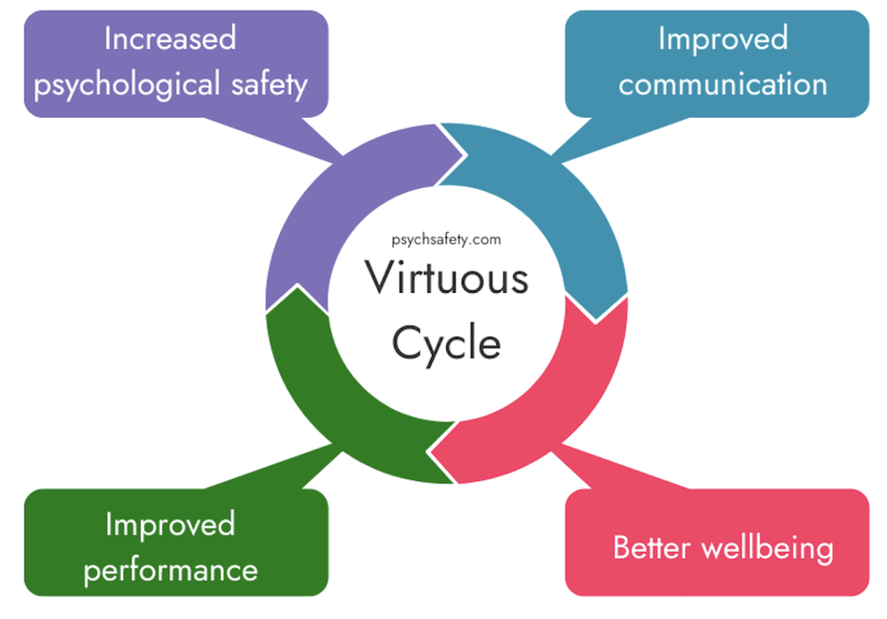
First Listener
  Create psychologically safe space
  Decision on seriousness of concern
    Serious escalate to Second Messenger
    Less serious no action required
    advice
    escalate
  Pastoral / health / wellbeing support sign-posting
  Anonymized documentation to Quality Team
  Feedback on next actions (if escalated)
Notes:
The most important aspect of being a first listener is to create psychological safety. Once you have heard the concern, the next step is to triage it to determine whether it is serious or requires escalation.
As a peer ally, it’s important to have a low threshold for escalation. This may be to get guidance on whether the concern is serious or not, or it may simply to get some on advice on how to approach the situation. Advice you can provide yourself might include ideas on how to challenge microaggressions in a non-threatening way. Questioning to get at the underlying assumption can be helpful. In the case of constantly being mistaken for a colleague of a similar ethnicity, you might say, “I’ve noticed you’ve mixed me up with …. a couple of times. I wonder why that might be?“ The observation on it’s own may be enough to spark reflection. This is also a useful technique when acting as an ally in the workplace.
If you think formal pastoral support is required, you will need to refer to the school wellbeing lead to identify an appropriate individual. If you have concerns about the trainee’s health, again, this will need escalating so that appropriate OH referrals can be made. It’s also fine to direct the trainee to their own GP if they have not yet sought help. GPs can be an important source of support in this situation. There is a wellbeing hub on the Lead Employer website, and links to this and other sources of support can be found in the raising concerns trainee guidance. Links include resources for bullying and discrimination, mental health and wellbeing support, crisis support and support for those who have experienced or witnessed sexual misconduct. If you fear that someone is so unwell that they may have suicidal thoughts, it’s ok to ask about this – it has been shown to be protective to ask this question, rather than to increase risk. More detailed guidance on what to do in this situation can be found in the first listener guidance.
Documentation involves the completion of an anonymised form which can be found on the EDI page of the deanery website. Your name is required, but not that of the trainee who has approached you.

Slide 24

Difference between a peer ally and supervisor as first listener
  First listener guidance - primarily aimed at supervisors
  Structured approach to hearing the concern
  Emphasis on believing trainee’s account and empathizing effectively
  Non-judgmental approach
  As a peer ally, you may take a more informal approach
  Important to remember elements such as confidentiality (and its limits), active listening, and appropriate boundaries
Notes:
As you may know if you have tried to raise a concern yourself, it is possible that you may be met with scepticism, to be told you are being “too sensitive,” or even more negative reactions. Much of the first listener guidance focuses on why it is important not to behave in that way. So you may choose to take a more informal approach to hearing the concern, and it is perfectly ok to validate the trainee’s interpretation of events. The principles of active listening remain important. You may feel like you recognise what you are hearing from your own experience, and it can be tempting to interrupt with your story at this point. However, it’s important that the trainee is able to tell their whole story, and for you to concentrate on listening to what is said, as well as what is not said. The trainee may have a different interpretation than you, or may experience a different response. The crucial factor in empathising effectively is to respond to the emotions you are detecting, rather than the ones you expect. It’s fine to clarify or ask eg “how did that make you feel?” or “am I right that this has been very upsetting for you?”
It is common for trainee’s not to raise a concern until they feel it is affecting how their performance is being judged, or when they feel they are being treated unfairly. Whilst it is natural to want to help and reassure in this situation, this will be a situation which always requires escalation.
Boundaries are important, both for the trainee raising the concern, and yourself. It’s fine to explain how the peer ally system works, checking that they understand that the purpose is the initial meeting to hear the concern, and escalate in a safe way if necessary. There may be a shorter second meeting to feed back next steps. At each meeting, you should explain how much time you have available. It is sensible to try and limit this to an hour for the first meeting, and half an hour for any follow up meeting.

Slide 25
Process
    Trainee submits request via short form on Raising Dignity concerns web page
    Angela matches with peer ally
    Peer ally receives email request from Angela
    Peer ally accepts (or declines) and contacts trainee
    Decision re: date, time, venue (if F2F) or Teams
Notes:
As you may know if you have tried to raise a concern yourself, it is possible that you may be met with scepticism, to be told you are being “too sensitive,” or even more negative reactions. Much of the first listener guidance focuses on why it is important not to behave in that way. So you may choose to take a more informal approach to hearing the concern, and it is perfectly ok to validate the trainee’s interpretation of events. The principles of active listening remain important. You may feel like you recognise what you are hearing from your own experience, and it can be tempting to interrupt with your story at this point. However, it’s important that the trainee is able to tell their whole story, and for you to concentrate on listening to what is said, as well as what is not said. The trainee may have a different interpretation than you, or may experience a different response. The crucial factor in empathising effectively is to respond to the emotions you are detecting, rather than the ones you expect. It’s fine to clarify or ask eg “how did that make you feel?” or “am I right that this has been very upsetting for you?”
It is common for trainee’s not to raise a concern until they feel it is affecting how their performance is being judged, or when they feel they are being treated unfairly. Whilst it is natural to want to help and reassure in this situation, this will be a situation which always requires escalation.
Boundaries are important, both for the trainee raising the concern, and yourself. It’s fine to explain how the peer ally system works, checking that they understand that the purpose is the initial meeting to hear the concern, and escalate in a safe way if necessary. There may be a shorter second meeting to feed back next steps. At each meeting, you should explain how much time you have available. It is sensible to try and limit this to an hour for the first meeting, and half an hour for any follow up meeting.

Slide 26

How to start
  Introductions
  Explain your role a peer ally – hear the concern, discussion of possible next steps (if necessary), decision on escalation, signposting
  Also explain
    confidentiality and its limits
    escalation process (can wait until after concern heard)
    how much time you have
    system of anonymous documentation
Notes:
As you may know if you have tried to raise a concern yourself, it is possible that you may be met with scepticism, to be told you are being “too sensitive,” or even more negative reactions. Much of the first listener guidance focuses on why it is important not to behave in that way. So you may choose to take a more informal approach to hearing the concern, and it is perfectly ok to validate the trainee’s interpretation of events. The principles of active listening remain important. You may feel like you recognise what you are hearing from your own experience, and it can be tempting to interrupt with your story at this point. However, it’s important that the trainee is able to tell their whole story, and for you to concentrate on listening to what is said, as well as what is not said. The trainee may have a different interpretation than you, or may experience a different response. The crucial factor in empathising effectively is to respond to the emotions you are detecting, rather than the ones you expect. It’s fine to clarify or ask eg “how did that make you feel?” or “am I right that this has been very upsetting for you?”
It is common for trainee’s not to raise a concern until they feel it is affecting how their performance is being judged, or when they feel they are being treated unfairly. Whilst it is natural to want to help and reassure in this situation, this will be a situation which always requires escalation.
Boundaries are important, both for the trainee raising the concern, and yourself. It’s fine to explain how the peer ally system works, checking that they understand that the purpose is the initial meeting to hear the concern, and escalate in a safe way if necessary. There may be a shorter second meeting to feed back next steps. At each meeting, you should explain how much time you have available. It is sensible to try and limit this to an hour for the first meeting, and half an hour for any follow up meeting.

Slide 27
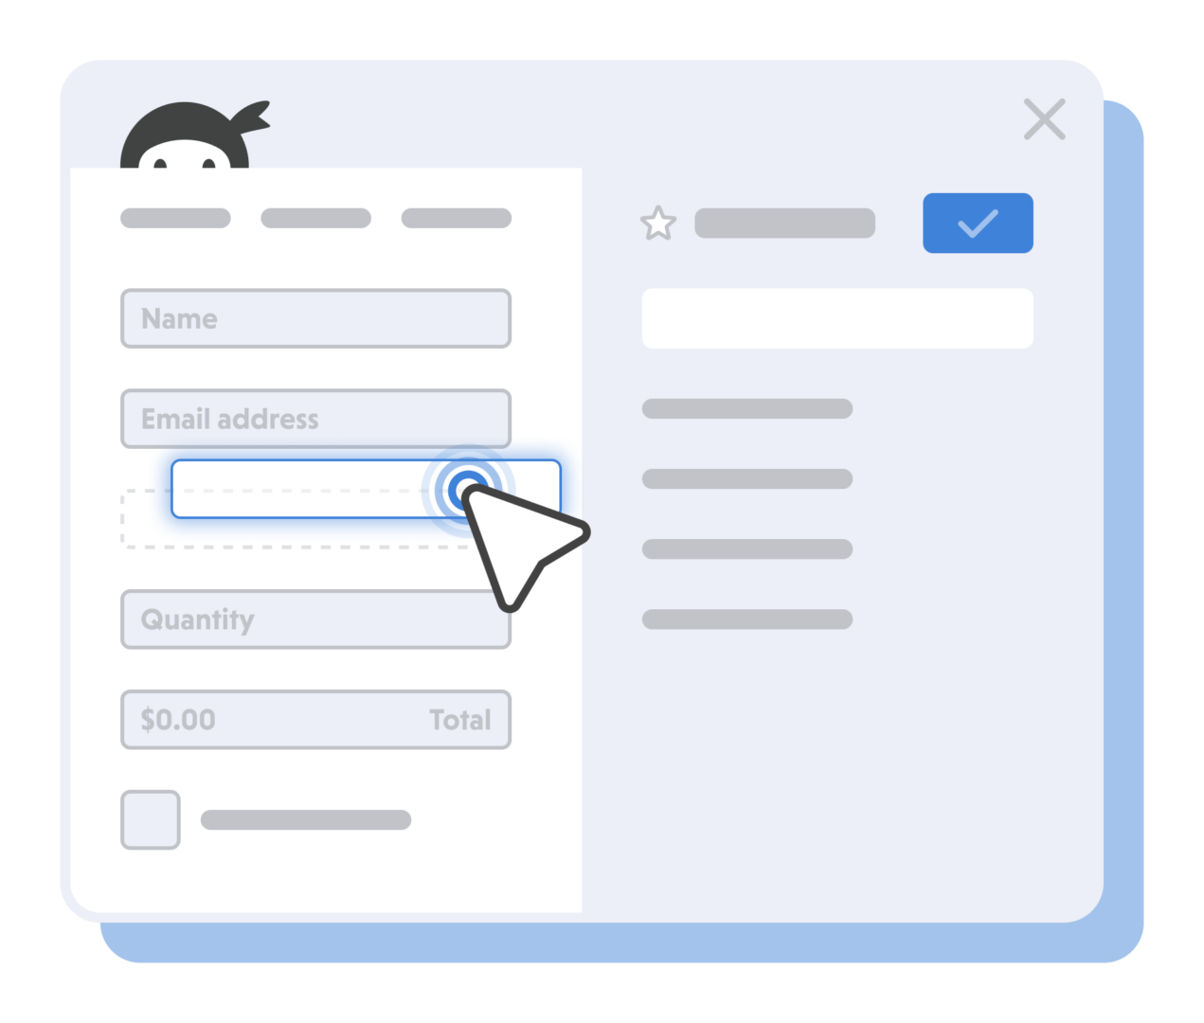
Documentation
  Quality recording form on Raising Concerns page of deanery website
  Your details recorded, but name of trainee raising concern is not
  Complete form with trainee
  Record what they are comfortable with – specialty as minimum, ideally including trust (can leave out grade)
  Explain the forms are only used to identify themes
  In details of concern, can describe issue rather than a lot of details about incident(s) – eg microaggression, bullying, unfairness, exclusion.
  Any protected / non-protected characteristics
Notes:
As you may know if you have tried to raise a concern yourself, it is possible that you may be met with scepticism, to be told you are being “too sensitive,” or even more negative reactions. Much of the first listener guidance focuses on why it is important not to behave in that way. So you may choose to take a more informal approach to hearing the concern, and it is perfectly ok to validate the trainee’s interpretation of events. The principles of active listening remain important. You may feel like you recognise what you are hearing from your own experience, and it can be tempting to interrupt with your story at this point. However, it’s important that the trainee is able to tell their whole story, and for you to concentrate on listening to what is said, as well as what is not said. The trainee may have a different interpretation than you, or may experience a different response. The crucial factor in empathising effectively is to respond to the emotions you are detecting, rather than the ones you expect. It’s fine to clarify or ask eg “how did that make you feel?” or “am I right that this has been very upsetting for you?”
It is common for trainee’s not to raise a concern until they feel it is affecting how their performance is being judged, or when they feel they are being treated unfairly. Whilst it is natural to want to help and reassure in this situation, this will be a situation which always requires escalation.
Boundaries are important, both for the trainee raising the concern, and yourself. It’s fine to explain how the peer ally system works, checking that they understand that the purpose is the initial meeting to hear the concern, and escalate in a safe way if necessary. There may be a shorter second meeting to feed back next steps. At each meeting, you should explain how much time you have available. It is sensible to try and limit this to an hour for the first meeting, and half an hour for any follow up meeting.

Slide 28
Serious concerns
  Sexual safety incidents
  Discrimination
  Bullying and harassment
  Trainee does not wish CS/ES/TPD to be told
  Where there is a health concern
  Potential for wider staff or patient safety impact
  Where the trainee wants to move placements or raise a formal allegation
Notes:
First Listeners (especially yourselves as Peer Allies) will be expected to have a very low threshold for escalating. For early or more minor concerns, the second messenger conversation may be appropriate as a first step.
Sometimes it’s easier to think what is a less serious concern (note, they are all serious, it’s just a matter of degree). Examples of less serious concerns include microaggressions which the trainee is agreeable to discussing themselves, supervisors who are being impatient, minor instances of incivility, or inequitable training opportunities which sound like they might be easily remediable. We anticipate that trainees will often not want to escalate, and this is fine, so long as you don’t have concerns about the trainee’s wellbeing, or wider safety of patients or team. The trainee may feel much better just from talking things through with you. If you have any worries at all, the next step will be to encourage the trainee to meet with a wellbeing or EDI lead to get more senior confidential support – there will be more than one option for you to choose from.

Slide 29
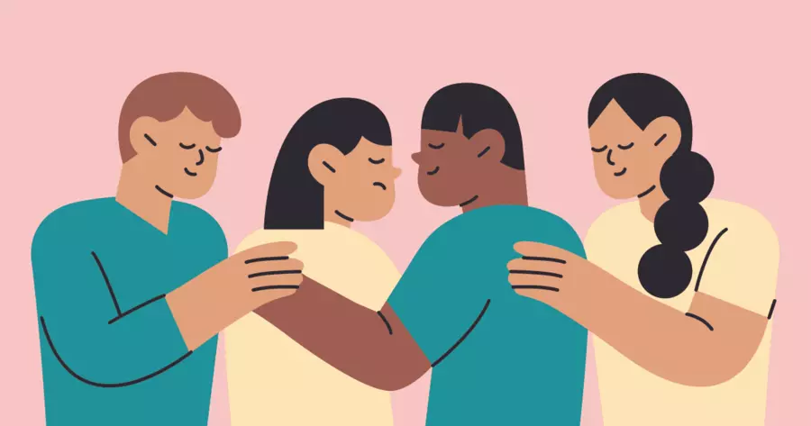
Support for peer allies
  Acting as a first listener is rewarding, but can be emotionally draining or even triggering
  Important to have someone to debrief with:
    Each other
    Wellbeing leads / EDI leads
    EDI team
  Managing numbers and distribution
  You can withdraw from the role at any time
  Potential for Balint groups

Slide 30
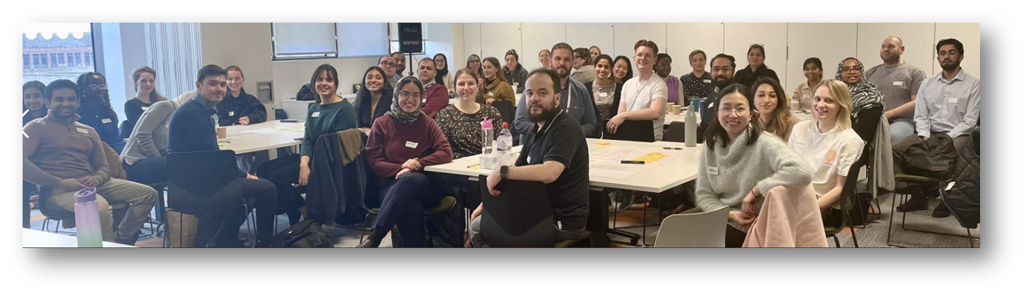
What happens now?
  Guidance has been launched
  If you would like to be a peer ally:
    Let Angela McMahon know and complete joining form
    Watch webinar recording / look at slide set
    Await referrals
    Ensure you check emails daily!
    Let Angela know if you need to withdraw
    Can ‘practice’ on each other

Slide 31


