Slide 1

SuppoRTT
Supported Return to Training
in the North West
Presented by:
Notes:
Standard title slide

Slide 2
Background
At least 10% of people are out of training at any time
2016 | The 2016 ACAS junior doctors’ contract agreement committed NHS England (formerly HEE) to develop innovative, evidence-based initiatives to “remove as far as possible the disadvantage of those who take time out.
2017 | National SuppoRTT Strategy & Investment Plan published
2018 | NW SuppoRTT Programme began

Slide 3
Eligibility
All Doctors, Dentists and Public Health practitioners in training with an NTN who have a break in training of 3 months or more.
Those with a shorter break can also access SuppoRTT if they feel it will benefit them
Parental Leave
(adoption, maternity, shared parental leave)
OOP
( C / E / P / R / T )
Long-term sickness
(planned and unplanned)
Discretionary Offer
International Medical Graduates new to the NHS starting 1st training post/started in last 6 months*
Career break prior to starting new programme
(i.e. F3 year)
Bereavement, Carers Leave
Disciplinary Action
Notes:
*More info about discretionary offer later in the presentation

Slide 4
The SuppoRTT Process
Pre-Absence
meeting & form
6-8 weeks before starting time out**
Pre-Return
meeting & form
8-12 weeks before returning to training
Enhanced Supervision period
at least 10 working days on return
Post-Return Review
meeting & form
2-4 weeks after return
**if time out is unplanned the pre-absence meeting may not be possible/relevant
Notes:
The meetings are usually with an educational supervisor but can also be with a TPD, Clinical Supervisor, College Tutor, SuppoRTT Champion. Each meeting has a form to go with it which can help guide the discussion and is a useful place to record information that can then be shared more widely, for info and action.

Slide 5






SuppoRTT Meetings & Forms
An opportunity to talk (virtually or face-to-face) about the break from training and any concerns around it
Online forms submitted to NW SuppoRTT Team automatically shared by email so relevant info can be known and actioned
Discuss what and how contact will be made during break to stay connected with the workplace/training programme
Review work-place issues e.g. rota, induction, breastfeeding etc.
Look at what activities may be useful to help prepare for return to training (i.e. NW SuppoRTT Course etc.)
Plan/extend enhanced supervision period (pre-return/post-return review)
Notes:
The NW SuppoRTT team also rely on the forms being submitted so they can report accurate figures nationally and justify the budget allocated each year

Slide 6
Enhanced Supervision Period
“a short, intensive period of enhanced supervised practice, focused learning activities and direct observation of clinical activities with the aim of enabling colleagues in training to return to normal duties safely and confidently. It is expected that during this time they may not be required to undertake any out of hours arrangements if adequate supervision isn’t available.”
NHSE recommends a minimum of 10 working days immediately upon return
Each School approaches this period slightly differently for the benefit of their colleagues in training
The enhanced supervision period can be extended if more time is required via the Post-Return Review meeting/form

Slide 7
KIT, SPLIT and SRTT Days
What | When | How Many | Reimbursement | Comments
KIT Day | Maternity Leave whilst in receipt of SMP – weeks 2 - 39 | 10 | Paid basic salary minus the SMP already paid for that day | If someone goes on Maternity Leave and then Shared Parental Leave, they are entitled to 10 KIT days in the mat leave period plus 20 SPLIT days in the Shared Parental Leave period
SPLIT Day | Shared Parental Leave | 20 | Paid basic salary
SRTT Day (Maternity Leave) | Maternity Leave – unpaid period (after week 39) | Combined total of 10 KIT and SRTT days | Paid basic salary
 | Maternity Leave – accrued annual leave period |  | Additional day of annual leave to be taken prior to return | These days should be applied for at least 8 weeks in advance as they push the RTT date back
SRTT Day (OOP) | During any OOP | 10 | TOIL at returning host organisation post return
Notes:
KIT = Keeping in Touch, SPLIT = Shared Parental in Touch SRTT = Supported Return to Training
These are days that people can access to help them stay connected with the workplace as well as prepare for their return to training
People on Long-term Sick are not eligible for reimbursement of time, as they are already being paid and should not be doing anything that would be classed as work whilst they have a Fit Note. The Lead Employer have agreed that people can do the NW SuppoRTT Course whilst on sick leave as this directly supports their return to work/training.

Slide 8


Return to Training Activities (RTT-A)
Application Process
(joint process with Lead Employer)
Days (i.e. KIT/SRTT) and funding applied for in 1 form
Days reimbursed by Lead Employer/host
Funding from NHSE paid by LE payroll, unless on OOP then will be directly by NHSE
Application form available on our website https://nwpgmd.nhs.uk/supportt-activities
To access funding at least 1 meeting form must be submitted and the activity noted on there
List of School Approved Activities on website
TPDs may be contacted to ensure activity is appropriate for that colleague in training
Notes:
The days can be used for clinical activities like observation/shadowing etc., clinical skills refresher courses, knowledge updates, e-learning etc.
SuppoRTT funding is available when study leave is not
The most up to date guidance will always be available on the website https://www.nwpgmd.nhs.uk/supportt-activities

Slide 9


Return to Training Activities (RTT-A)
NHSE Funded Opportunities
The NW SuppoRTT Team arrange various activities centrally for colleagues in training to access free of charge.
Please visit the website for more information.
Virtual Courses
Overcoming Imposter Feelings
½ day interactive webinar delivered by Sally Beyer
Shapes Toolkit
1 day online course delivered by Wild Monday
https://nwpgmd.nhs.uk/supportt-activities-calendar
Coaching for SuppoRTT
Delivered by Westwood Coaching Associates Ltd.
Referrals can be made by:
Associate Deans
Educational Supervisors
TPDs
SuppoRTT Champions
College Tutors
TSTLs
https://nwpgmd.nhs.uk/supportt-coaching

Slide 10


Return to Training Activities (RTT-A)
NW SuppoRTT Course https://nwpgmd.nhs.uk/nw-supportt-course
Day 1
Day 2
Day 3
A virtual day which covers:
General issues faced by returners
The SuppoRTT process
LTFT training
Communication Skills
Decision Making
Understanding Stress Responses
A face-to-face day at a simulation centre in either Aintree, Preston or Whiston which covers:
Communication Skills
Resus Skills
Acute medical/surgical emergencies (tailored to delegates’ situations) with facilitated debrief
A specialty specific day designed to cover niche aspects of returning to training in that school including simulated scenarios. Not all Schools have a Day 3.
Please visit the website for more details including dates and booking information.
Notes:
Lancashire Teaching Hospitals NHS Foundation Trust are contracted to deliver Days 1 and 2 of the course and have been doing so since 2018.
Day 3 is designed and delivered by the School SuppoRTT Champions

Slide 11
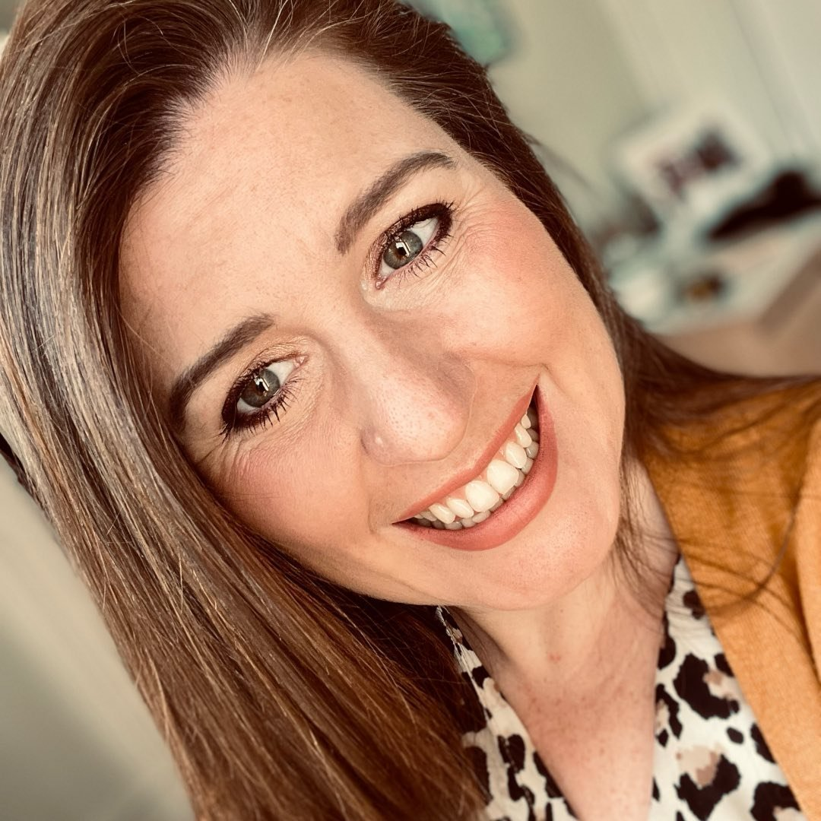
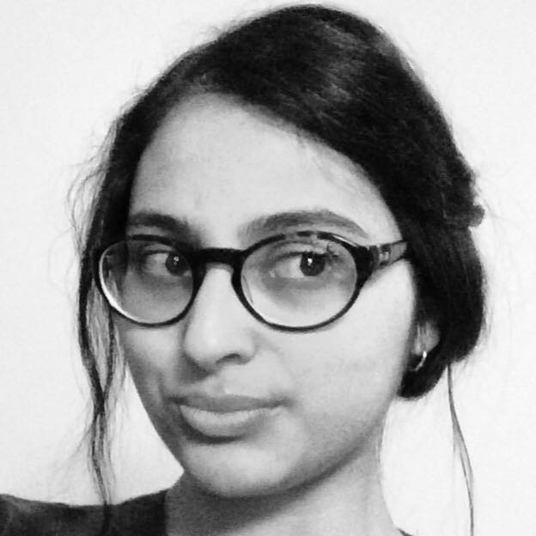
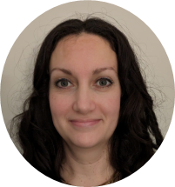
NW SuppoRTT Fellows
What the Fellowship is…
What the Fellows do…
What the Fellows get…
Postgraduate Doctor, Dentist, Public Health practitioner in training
Quality Improvement and Innovation
Secondment for 12-18 months
40% Fellowship
Has experience returning to training
Collaborate with stakeholders to effect change
Conduct user engagement projects
Implement improvements to programme
Manage Peer SuppoRTT Rep Network
Work with other Fellows around the country
The chance to develop new initiatives and leave a lasting mark on the programme
Leadership opportunities
Personal development opportunities
1-1 Coaching
A greater understanding of the other side of training
Notes:
The Fellowships are recruited via TRAC

Slide 12
SuppoRTT Champions
https://nwpgmd.nhs.uk/supportt-contacts
Trust SuppoRTT Champions
School SuppoRTT Champions
Breastfeeding support
Enhanced supervision
Identifying Educational Supervisor
Induction
KIT/SPLT/SRTT days
Rota support
Signpost to local training/courses
Workplace issues
Curriculum queries
Day 3 of NW SuppoRTT Course
Finding a mentor
RTT Activities
Specialty specific issues
Peer SuppoRTT Reps
Peer support, advice and guidance

Slide 13












Resources

Slide 14





Peer Support
Virtual Coffee Catch Ups with our NW SuppoRTT Fellows every fortnight
RTT Social each quarter with our Fellows/Peer SuppoRTT Reps around the region
NW SuppoRTT WhatsApp Group
National SuppoRTT Facebook Group
Peer SuppoRTT Reps in each School

Slide 15




Discretionary Offer of SuppoRTT
International Medical Graduates
Any IMG with an NTN starting their first training post in the NHS, or who has started in the past 6 months
What’s included in the offer:
Enhanced supervision period
NW SuppoRTT Course
SuppoRTT Champions
Peer Support
Overcoming Imposter Feelings interactive webinar
Shapes Toolkit online course
Coaching
Resources on NW SuppoRTT website
What’s not included in the offer:
RTT-A Funding
IMGs in GP training programmes who do their first 6-12 months in a GP practice can access SuppoRTT for their first hospital training post
Complete the pre-return form to register with the programme and access the resources
Notes:
The pre-return form has been updated to make it more relevant for IMGs to complete.

Slide 16



Returning from sickness
Occupational Health recommendations for RTW take precedence
Enhanced supervision period following phased return for RTT
NW SuppoRTT Course can be done to prepare for return
Resources | https://nwpgmd.nhs.uk/supportt-trainee-resources
Time out for
health reasons
Infographic
Mental Health
Toolkit
Immersive
Tech
Resources
Notes:
The MH Toolkit was developed by Matthew Palethorpe when he was in Core Anaesthetics
The Immersive Tech Resources include Remote consultation, Teamworking in Medicine, Paediatrics & Surgery, Escalating concerns and speaking up

Slide 17

Contacts
 | NW SuppoRTT Website https://www.nwpgmd.nhs.uk/supported-return-to-training
 | NW SuppoRTT Team england.supportt.nw@nhs.net
 | Your Name Email Address
Notes:
Plain slide with subhead and bullets

Slide 18
End slide

